Slide 1
CS 3800: Computer Networks Session 1: Introduction
Kalin Zaluzec
Department of Computer Science
Cal Poly Pomona

Slide 2
Outline of Lecture
Course Information
Introduction

Slide 3
Course Information
Topics:
Number representation, integer arithmetic. von Neumann machine. Instruction set architecture. Addressing modes. Assembly programming. Arrays and records. Subroutines and macros. Interrupts. I/O interfacing and communication
Prerequisites:
C or better in CS 130 or CS 1300 and CS 141 or CS 1400.

Slide 4
Course Information (Cont’d)
Learning outcomes (at minimum):
Understand the network architecture design process
Understand the prominent protocols at various levels in layered protocol design
Become familiar with recent computer network technologies

Slide 5

Course Information (Cont’d)
Textbook
Computer Networking A Top-Down Approach, 8th Edition, by James F Kurose & Keith W. Ross

Slide 6
Course Information (Cont’d)
Technical Requirements
Computer with virtualization support
Virtual box, VMware, etc.
Python

Slide 7
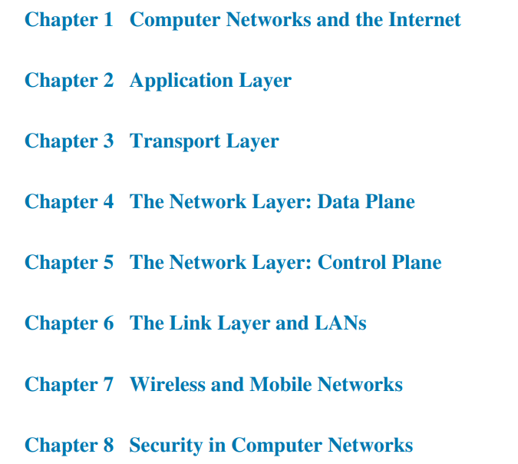
Course Information (Cont’d)
Course will roughly cover topics as ordered in the text book
Likely won’t take all semester to get through these topics
Extra topics added depending on pace of the class

Slide 8
Course Information (Cont’d)
Canvas
Syllabus
Class Notes
Slides posted day of class
Assignments
Posted after class
Pay attention to due dates
Posting grades
Class emails

Slide 9
Course Information (Cont’d)
Grading Policy:
Attendance/Participation: 10%
Homework/Labs: 50%
Exams: 40% (2 midterms, 1 final, lowest score dropped)
Final letter grades will be based on your overall score as follows (subject to change):
A ≥ 90
90 > B+ ≥ 86
86 > B ≥ 80
80 > C+ ≥ 76
76 > C ≥ 70
70 > D+ ≥ 66
66 > D ≥ 60
60 > F

Slide 10
Course Information (Cont’d)
Late Assignment Policy
All assignments are expected to be submitted by the specified deadline, but they will (usually) remain open for a week after the deadline)
Honor Code
All assignments, unless explicitly specified, are to be your own work
Collaboration is permitted, so long as it is properly documented
Evidence of cheating, plagiarism, or unauthorized collaboration will result in a 0 grade for quiz/assignment/exam

Slide 11
Asynchronous class
Mondays
Mostly lectures
Occasional collected in-class activities (you will know ahead of time)
Exams
Wednesdays
Asynchronous labs
Pre-recorded lectures

Slide 12
How to do Well in This Class
Attendance
Try to attend every class
Ask questions
Notes
Take notes and review notes after class
Homework
Get started early
Contact me if you encounter problems

Slide 13
How to Get Help?
Ask questions in class or after class
Attend office hours
Email me
Put “CS3800” in the subject line
Send it from your .cpp account
Class Discord (preferred method)
https://discord.gg/avh2KB4N
Note: If you direct message me about something important (like missing a class or making up an assignment), include your name!

Slide 14
Exams
3 exams (lowest score dropped)
You can skip the final if you do well on both midterms
To be completed during class time
All exams open-notes

Slide 15
Introductions
Tell us about yourself,
Name/Year/Major
Something interesting about yourself
Expectation in this class
Optional: Any questions for me?

Slide 16
Outline of Lecture
Course Information
Introduction

Slide 17

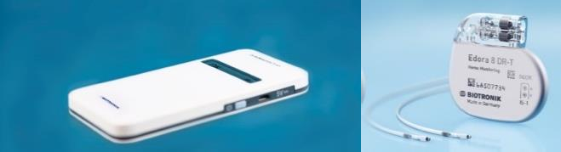

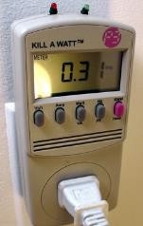
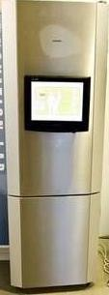



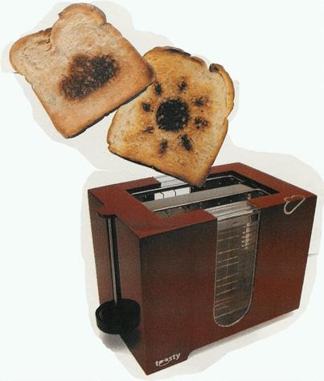
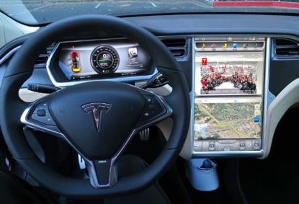


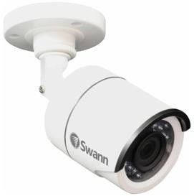
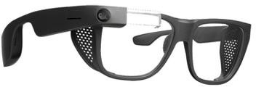

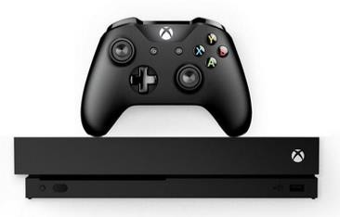
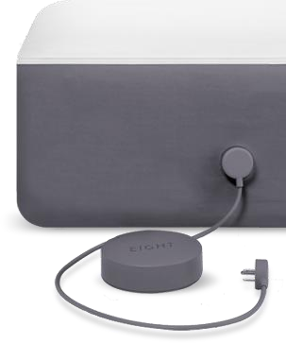
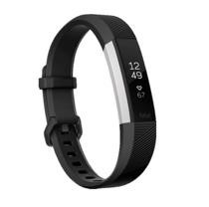
Internet of Connected Devices
Tweet-a-watt: monitor energy use
Pacemaker & Monitor
bikes
Amazon Echo
Web-enabled toaster + weather forecaster
IP picture frame
Internet refrigerator
Slingbox: remote control cable TV
cars
AR devices
Security Camera
sensorized, bed mattress
scooters
Others?
Gaming devices
Fitbit
Internet phones

Slide 18
























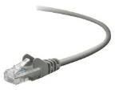


















The Internet: A “Nuts and Bolts” View
Billions of connected
computing devices:
hosts = end systems
running network apps at
Internet’s “edge”
Communication links
Optical fiber, copper wire , radio, satellite
transmission rate: bandwidth
Packet switches: forward
packets (chunks of data)
routers, link-layer switches
Networks
collection of devices, routers, links: managed by an organization
mobile network
national or global ISP
local or regional ISP
In
home network
content provider network
datacenter
network
enterprise
network

Slide 19













The Internet: A “Nuts and Bolts” View
mobile network
4G
national or global ISP
Internet: “network of networks”
Interconnected ISPs
Skype
IP
protocols are everywhere
control sending, receiving of messages
e.g., HTTP (Web), streaming video, Skype, TCP, IP, WiFi, 4/5G, Ethernet
Streaming
local or regional ISP
video
home network
content provider network
HTTP
datacenter network
Internet standards
RFC: Request for Comments
IETF: Internet Engineering Task
Force
Ethernet
TCP
enterprise
network
WiFi

Slide 20









The Internet: A “Services” View
mobile network
Infrastructure that provides services to
applications:
Web, streaming video, multimedia
national or global ISP
teleconferencing, email, games, e- commerce, social media, inter- connected appliances, …
Streaming video
Skype
local or regional ISP
provides programming interface
to distributed applications:
“hooks” allowing sending/receiving apps to “connect” to, use Internet transport service
provides service options, analogous to postal service
home network
content provider network
HTTP
datacenter network
enterprise
network

Slide 21
What is a Protocol?
Human protocols:
“what’s the time?”
“I have a question”
introductions
Rules for:
… specific messages sent
and
… specific actions taken when message received, or other events
Network protocols:
computers (devices) rather than humans
all communication activity in Internet governed by protocols
Protocols define the format, order of messages sent and received among network entities, and actions taken on message transmission, receipt

Slide 22





What is a Protocol?
A human protocol and a computer network protocol:
Hi
TCP connection
request
Hi
TCP connection
response
Got the
time?
GET http://gaia.cs.umass.edu/kurose_ross
2:00
<file>
time

Slide 23

Next Session (also today):
What is the Internet?
What is a protocol?
Network edge: hosts, access network, physical media
Network core: packet/circuit switching, internet structure

Slide 24







A closer look at Internet Structure
mobile network
Network edge:
hosts: clients and servers
servers often in data centers
national or global ISP
local or regional ISP
home network
content provider network
datacenter
network
enterprise
network

Slide 25
A closer look at Internet Structure
Network edge:
hosts: clients and servers
servers often in data centers
Access networks, physical media:
wired, wireless communication links
mobile network
national or global ISP
local or regional ISP
home network _{content}
provider
network datacenter
network
enterprise
network

Slide 26
A closer look at Internet Structure
mobile network
Network edge:
hosts: clients and servers
servers often in data centers
Access networks, physical media:
wired, wireless communication links
Network core:
national or global ISP
local or regional
ISP
home network
content provider network
datacenter
network
interconnected routers
network of networks
enterprise
network

Slide 27
Access Networks and Physical Media
Q: How to connect end systems to
edge routers?
A: Access Networks
Residential Access Nets
Institutional Access Networks (school, company)
Mobile Access Networks (WiFi, 4G/5G)
mobile network
national or global ISP
local or regional ISP
home network _{content}
provider
network datacenter
network
enterprise
network

Slide 28









Access Network: Digital Subscriber Line (DSL)
central office
telephone network
DSL
modem
splitter
DSLAM
voice, data transmitted
ISP
at different frequencies over
DSL access multiplexer
dedicated line to central office
Use existing telephone line to central office DSLAM
Data over DSL phone line goes to Internet
Voice over DSL phone line goes to telephone net
24-52 Mbps dedicated downstream transmission rate
3.5-16 Mbps dedicated upstream transmission rate

Slide 29
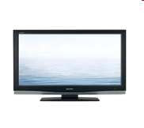







Access Network: Cable-Based Access
cable headend
…
cable modem
splitter
 |  |  |  |  |  |  |  | C
 |  |  |  |  |  |  |  | O
V | V | V | V | V | V |  |  | N
I | I | I | I | I | I | D | D | T
D | D | D | D | D | D | A | A | R
E | E | E | E | E | E | T | T | O
O | O | O | O | O | O | A | A | L
1 | 2 | 3 | 4 | 5 | 6 | 7 | 8 | 9
Channels
frequency division multiplexing (FDM): different channels transmitted in
different frequency bands
15

Slide 30



Access Network: Cable-Based Access
cable headend
…
cable modem
splitter
cable modem termination system
CMTS
data, TV transmitted at different
frequencies over shared cable
distribution network
ISP
HFC: hybrid fiber coax
asymmetric: up to 40 Mbps – 1.2 Gbps downstream transmission rate, 30-100 Mbps
upstream transmission rate
network of cable, fiber attaches homes to ISP router
homes share access network to cable headend

Slide 31
















Wireless Access Networks
Shared wireless access network connects end system to router
via base station aka “access point”
Wireless local area networks
(WLANs)
typically within or around
building (~100 ft)
802.11b/g/n (WiFi): 11, 54, 450
Mbps transmission rate
Wide-area cellular access networks
provided by mobile, cellular network
operator (10’s km)
10’s Mbps
4G/5G cellular networks
to Internet
to Internet

Slide 32

















Access Network: Enterprise Networks
Enterprise link to
ISP (Internet)
institutional router
Ethernet switch
institutional mail, web servers
companies, universities, etc.
mix of wired, wireless link technologies, connecting a mix of switches and routers to create a Local Area Network (LAN)
Ethernet: wired access at 100Mbps, 1Gbps, 10Gbps
WiFi: wireless access points at 11, 54, 450 Mbps

Slide 33




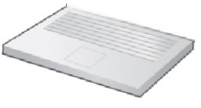




Access Network: Home Networks
Wireless and wired devices
to/from headend or
central office
often combined in single box
cable or DSL modem
WiFi wireless access
router, firewall, NAT
wired Ethernet (1 Gbps)
point (54, 450 Mbps)

Slide 34
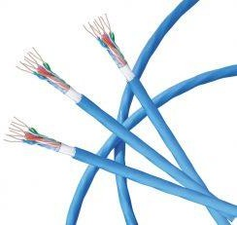
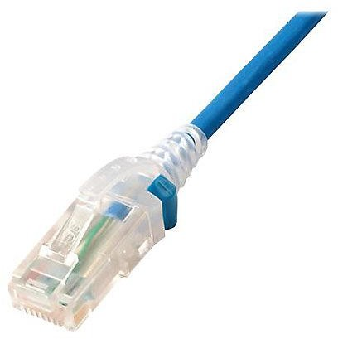
Links: Physical Media
bit: propagates between transmitter/receiver pairs
physical link: what lies between transmitter & receiver
guided media:
signals propagate in solid media: copper, fiber, coax
unguided media:
signals propagate freely, e.g., radio
Twisted pair (TP)
two insulated copper wires
Category 5: 100 Mbps, 1 Gbps Ethernet
Category 6: 10Gbps Ethernet

Slide 35
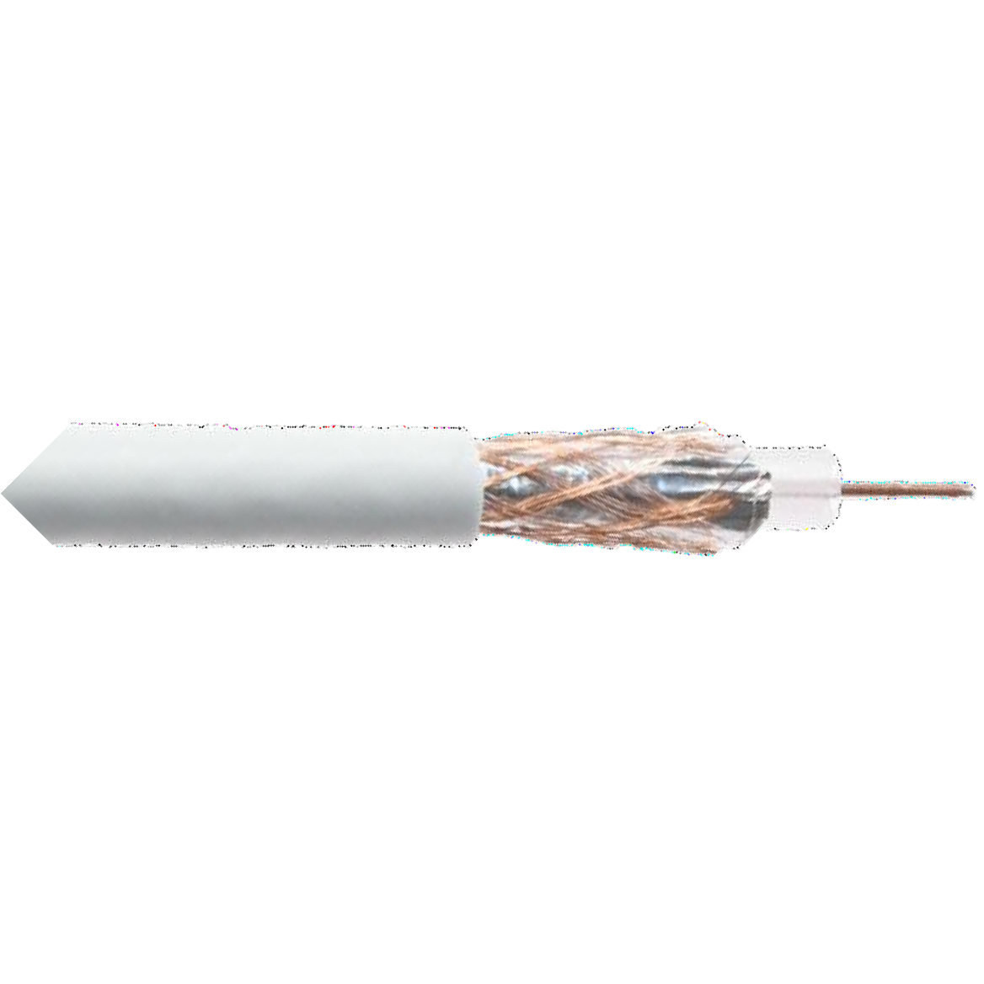
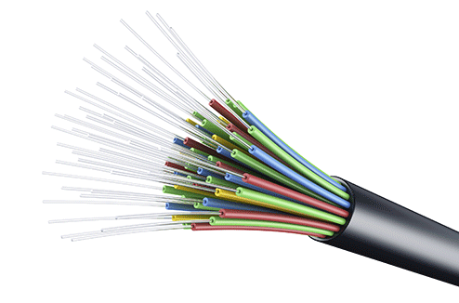
Links: Physical Media
Coaxial cable:
two concentric copper conductors
bidirectional
broadband:
multiple frequency channels on cable
100’s Mbps per channel
Fiber optic cable:
glass fiber carrying light pulses, each pulse a bit
high-speed operation:
high-speed point-to-point
transmission (10’s-100’s Gbps)
low error rate:
repeaters spaced far apart
immune to electromagnetic noise

Slide 36
Links: Physical Media
Wireless radio
signal carried in various “bands” in electromagnetic spectrum
no physical “wire”
broadcast, “half-duplex”
(sender to receiver)
propagation environment effects:
reflection
obstruction by objects
Interference/noise
Radio link types:
Wireless LAN (WiFi)
10-100’s Mbps; 10’s of meters
wide-area (e.g., 4G/5G cellular)
10’s Mbps (4G) over ~10 Km
Bluetooth: cable replacement
short distances, limited rates
terrestrial microwave
point-to-point; 45 Mbps channels
satellite
up to < 100 Mbps (Starlink) downlink
270 msec end-end delay (geostationary)

Slide 37
Next Session:
Network edge: hosts, access network, physical media
Network core: packet/circuit switching, internet structure
Performance: loss, delay, throughput
Layering, Service models
Security

Slide 38
Lab 1: Virtual Box Setup & Wireshark Intro
Due: Sunday February 2
Assignment remains open a week after deadline
Talk to me if you need more time
Rest of class today: Get virtual box running

